Slide 1
Biot-Savart Law
At any point P the magnitude of the magnetic field intensity produced by a differential element is proportional to the product of the current, the magnitude of the differential length, and the sine of the angle lying between the filament and a line connecting the filament to the point P at which the field is desired; also, the magnitude of the field is inversely proportional to the square of the distance from the filament to the point P. The constant of proportionality is 1/4π.
MATHEMATICALLY:

Slide 2
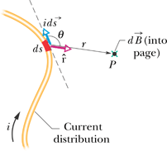

Biot-Savart Law
So, the magnetic field “circulates” around the wire

Slide 3
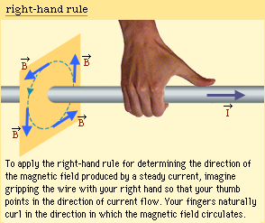

Slide 4
Applications of Biot Savart law
Application 1: Magnetic field due to a long straight wire

Slide 5

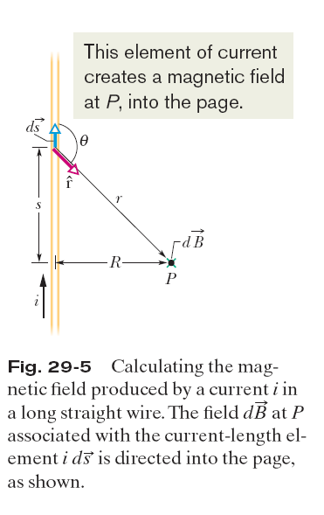



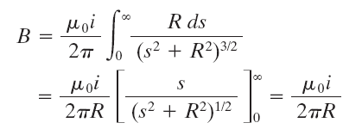

Slide 6
Application 2: Magnetic field from a circular current loop at point P
dB
dB_{z}
_{P}
Only z component
is nonzero.
dB_{perp}
r
z
dl
α
R
I
Notes:
6

Slide 7
Magnetic field from a circular current loop
B
dB_{z}
dB_{perp}
r
z
α
dl
At the center of the loop
R
I
At distance z on axis
from the loop, z>>R
Notes:
7

Slide 8
Magnetic field in terms of dipole moment
Far away on the axis,
B
The magnetic dipole moment of the loop is defined as m = IA =IπR².
The direction is given by the right hand rule: with fingers closed in
the direction of the current flow, the thumb points along m.
z
μ
R
I
Notes:
8

Slide 9

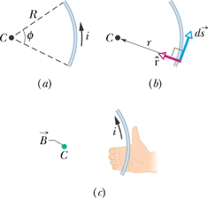

Special case: Magnetic Field Due to a Current in a Circular Arc of Wire

Slide 10
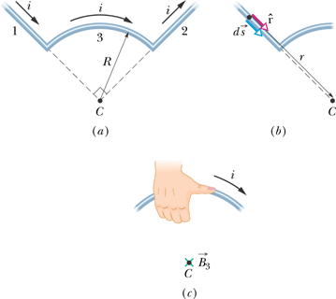
Sample Problem
The wire in Fig. ‘a’ carries a current i and consists of a circular arc of radius R and central angle rad, and two straight sections whose extensions intersect the center C of the arc. What magnetic field does the current produce at C ?

Slide 11
Force on 2 Parallel Current-Carrying Conductors
F
×
Calculate force on length L of wire b due to field of wire a:
The field at b due to a is given by:
I_{b}
d
L
I_{a}
⇒
Force on b =
⇒
Force on a =
I_{b}
d
L
I_{a}
×
F

Slide 12
Definition of Ampere:
This expression is used to define a standard 1 Ampere current:
“The constant current which will produce an attractive force of 2 × 10^{–7} Newton per metre of length between two straight, parallel conductors of infinite length and negligible circular cross section placed one metre apart in a vacuum.”

Slide 13
Ampere’s law and applications
Sum up component of B around path Equals current through surface.
Component of B along path
I
closed path
Ampere’s law
surface bounded by path

Slide 14
Ampere’s Law
No Different Physics from Biot-Savart Law
Useful in cases where there is a high degree of symmetry
Can be compared with Coulomb’s Law and Gauss’s Law in electrostatics in functionality.
Assignment 2: Prove Ampere’s law !

Slide 15
APPLICATIONS OF AMPERE’S LAW

Slide 16
Magnetic Field of ∞ Straight Wire
Calculate field at distance R from wire using Ampere's Law:
dl
Choose loop to be circle of radius R centered on the wire in a plane ⊥ to wire.
×
I
R
Evaluate line integral in Ampere’s Law:
Current enclosed by path = I
⇒
Apply Ampere’s Law:
Ampere's Law simplifies the calculation thanks to symmetry of the current! ( axial/cylindrical )

Slide 17
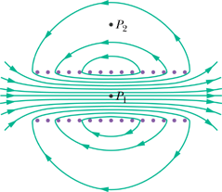
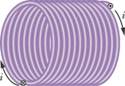
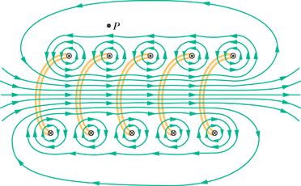
Magnetic Field of a Solenoid

Slide 18
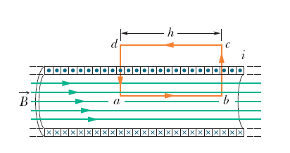

Slide 19


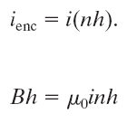


Here n be the number of turns per unit length of the solenoid

